Slide 1
Yoga For Clinicians
Kirana Rao MS,RD, LD

Slide 2
Objectives
At the end of the 30 minutes we will perform 3 yoga poses

Slide 3
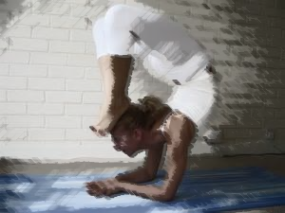

Slide 5
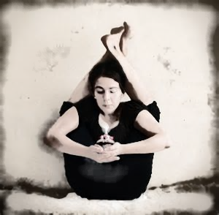

Slide 6
Objectives (for real)
What is Yoga?
Common Postural Problems for Clinicians.
Corrections with Yoga
Common Stress Issues for Clinicians.
Corrections with Yoga
Notes:
I am also hoping to get everyone up a little bit and moving, so we actually get to stretch some of the muscles today.

Slide 7
So What is Yoga?
Balance, Union, Yoking, Peace.
Notes:
Ask how many people in the room do or have ever tried yoga?

Slide 8
Meaning of Yoga
Finding our balance
Union “of all our physical, mental and spiritual faculties”
Peace and Happiness??
Yoga is very simple and universally accessible

Slide 9
How can we practice Yoga at work?
Stretching and moving
Deep Breathing
Mindfulness and Meditation
Notes:
I will show you a few things that you can do without looking like a dork at work. Point one reaches to the physical aspect, point two and three to the mental and spiritual aspects of Yoga.

Slide 10
Physical Aspects
Body and Posture

Slide 11
Reasons for Postural Problems in Clinicians
Long hours of sitting or standing in one place
Long hours of computer and Phone usage
Moving patients and awkward lifting and reaching (stability of the spine and weak core)
Notes:
> 60% of the work day, several times a week is considered prolonged standing

Slide 12
Long Standing and Sitting
Long sitting increases risk of
Heart disease, Cancer, DM and death
Long standing increases risk of
Fatigue and pain in muscles of feet, legs, back and neck
Inflammation of veins in legs
Joint locking, degenerative rheumatoid disease.
Notes:
Long times sitting is the new smoking cause CVA issues. But not much attention is paid to long term standing for several hours each day.
Set 20 minute timers on your phones. If sitting, get up and walk for a minute and look away from the computer screen into something distant for a minute every 20 minutes. If standing take a break, sit down or flex your hips and legs for a few minutes. When you go home, put legs up against wall for at least 20-30 minutes a day.

Slide 13
Legs against wall

Slide 14
Extended Computer and Phone Usage
Almost unavoidable in Modern Life

Slide 15
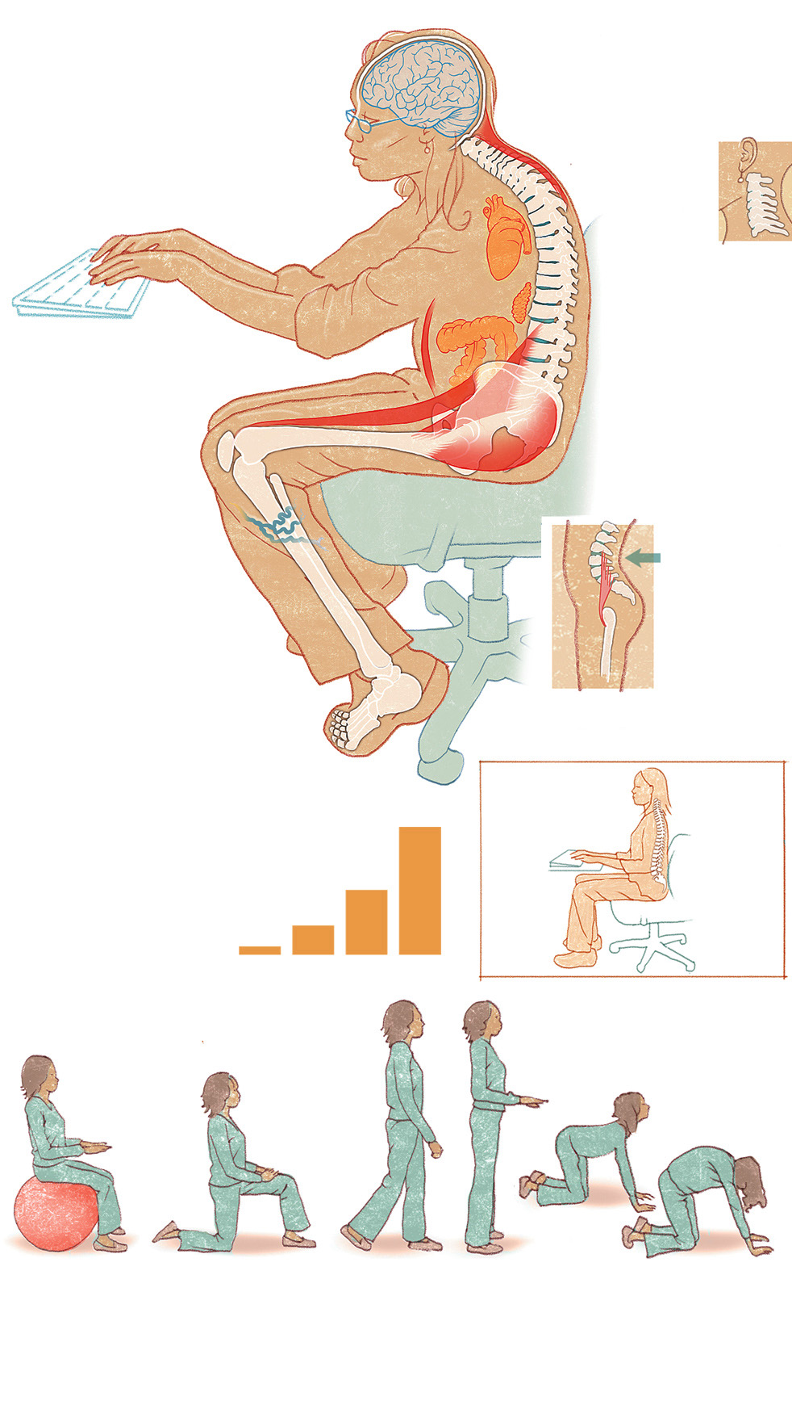
Notes:
Forward Head Posture – neck and shoulders rounded
Neck doesn’t slouch alone. Slumping forward overextends shoulder and back muscles as well, particularly the trapezius, which connects neck and shoulders
Lungs get squished in – inability to have strong chest and breathing muscles.
Mushy abs: When stand, move or sit up straight, abdominal muscles are working to keep you upright. But when you slump in a chair, they go unused.
5. Tight back muscles and inflexible spine. Movement enables the soft discs between verterbra to expand and contract like sponges, soaking up blood and nutrients. But when we sit for a long time, discs are squashed unevenly, collagen hardens around tendon and ligament.
6. Tight hips – hip flexors in front are rarely extended and become short and tight, limiting range of motion and stride length. Decreased hip mobility is one big reason why elderly tend to fall.
7. Limp glutes: Sitting requires your glutes to do absolutely nothing, and they get used to it. Soft glutes hurt your stability, your ability to push off and your ability to maintain a powerful stride

Slide 16
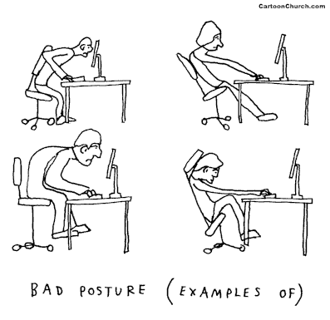

Slide 17
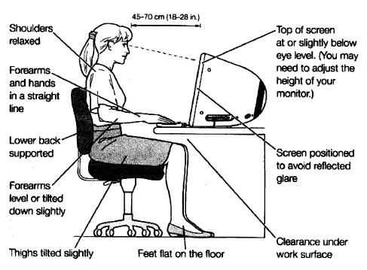
Notes:
Not leaning forward, arms close to sides, elbows bent 90 degrees.

Slide 19
Yoga for Neck and Shoulders
Look up from work every 5 minutes, bring phone to eye level
Exercises:
Neck Rolls
Seated Cat and Cow stretches
Wrap arms behind and overthe chair
Seated Eagle
Desk Shoulder opener
Notes:
Look up every 5 minutes, Phone to eye level – doesn’t look cool but at least no pain, Do some easy neck stretches and exercises
Seated forward bend with fingers interlaced also works on the shoulders and neckThe neck doesn't slouch alone. Slumping forward overextends shoulder and back muscles as well, particularly the trapezius, which connects the neck and shoulders

Slide 20
Yoga for Back
Seated Forward Bend with fingers interlaced behind
Seated Spinal Twist
Half dog against wall or chair back
Standing forward fold
What about the belly?
Notes:
Also helpful to put a pillow in your lower back to keep your natural curve.

Slide 21
Yoga for Legs, Hips and Glutes
Standing Pigeon
Standing Runners stretch
Chair Tree
Chair dancers pose without leaning forward
Seated Ankle to knee pose
Standing leg rises
Notes:
Long seating – causes poor circulation in legs, swollen ankles, varicose veins and DVT, decreased weight bearing – decreased bone mineral density. Weight bearing activity like walking is very important not only for legs but also your heart. Sitting is the current smoking – bad for health.

Slide 22
Yoga for other body parts
Carpal tunnel
Wrist Stretches and rolls
Eyes
Look away from screen every 5 minutes at something far away
Blink More
Eye exercises

Slide 23
Stable spine when lifting and moving people
Notes:
Most employees get an introduction to correct lifting in orientation. Nurses are encouraged to use chair lifts, but doesn’t happen practically due to many reasons. Reach to your physical therapist to see if you can come up with good solutions in your hospital for day to day issues. Learn how to lift properly. Lift with your legs not your back, keep heavy objects close to the body and maintain natural curve of spine as much as possible. Learn Proper posture – head balanced, chin not jutting forwards, chest raised slightly, stomach not stick out or protruding, relaxed knees, shoulders down and back, hips even at the same level, directly under the shoulders, kneecaps pointing straight ahead. Feet directly beneath the knees, facing forward. 3. Strengthen your body. 4. Manage your stress. Stressed workers are much more likely to become injured. If you experience stress at work more often than not, experiment with different

Slide 24
Yoga for Kidneys
All twisting and wringing actions of the body.
Mindfulness and relaxation
Immunity
Notes:
Reposition internal organs including kidneys and seem to be beneficial. Seated chair twists, back bends and forward bends are all beneficial.

Slide 25
Mental and Spiritual Aspects
For Clinicians

Slide 26
Yoga for the Mind
Common problems in Health Care Providers
Stress
Burn out
Anxiety
Attachment
Notes:
Some less obvious signs include neglecting basic needs like bathroom breaks, hydration, rest, eating well and sleep. How do most of us adapt to chronic stressful situation? Overeating/eating wrong things, too much caffeine or sugar, stimulants and drugs, we internalize stress and this shows up in poor posture

Slide 27
How can Yoga Help?
Reconnect to our internal reset button
Mindful Meditation
Breathing exercises
Strong mind body connection
Overall improved mood and well being
Stress reduction
Self acceptance
Improved concentration
makes us feel balanced and whole again
Notes:
We can take better care of others and don’t need to reach for things outside our body to get us through the day. Set timer for 2 minutes, close your eyes and shift thought gently back to the present
Not required to close your eyes, but most people find this very helpful. You can do it anywhere, while charting or sitting in front of the computer. Breathe in through one nostril and breath out through the other

Slide 28
Institution wide
On site Yoga classes in employee wellness option
Set a timer and move every 20 minutes when you are in front of the computer
Take 1-2 short mindfulness or awareness breaks where you re-check with yourself. .

Slide 29
Questions?
Thank you!

