Slide 1
US Health Care System
Why does it cost so much and what do we get?

Slide 2
The Business of Health Care

Slide 3
What is the Business of Healthcare?
Exchanging clinical services for remuneration ($$)
Licensed Independent practioners
Hospitals provide services with LIPs
Therapies (OT, PT, Speech)
How is it paid for?
Mostly some type of “insurance” or health plan

Slide 4
Is the Business of Healthcare different than other businesses ?
Who is paying?
Who chooses where the “purchase” happens?
Who chooses what to pay for?
Who is receiving services?
How does insurance fit in?

Slide 5
$$ The Money $$
Insurance Company
Employer
Family
Notes:
Before cases

Slide 6
$$ The Money $$
To understand the issues let’s review
What is paid
What we get for the $$
Patient perspective
Payer Perspective-who is paying

Slide 7
Insurance challenges- Employer
Self insured company- must pay for everything
Rate PP = {(last year’s cost PP) x (# Persons) x (inflation rate)}/ (# Persons)
“Re-insurance” above a cap included in above
Problem-two “outliers” >$500,000 cost
Solution: Raise rates or No raises ??

Slide 8
Insurance challenges- Family
Family of 5 with both parents employed
Mostly healthy
One child with moderate health issues
Problem- Rates skyrocketing
Solution??
Choose same rate with High deductible and HSA
What about the needed surgery?
Choose higher rate
Give up vacation? Give up activities?

Slide 9
Insurance challenges- Provider
Small multispecialty practice
Successful, new opportunity to join a PPO
Problem
Competition from new HMO they are shut out of
PPO rates 20% lower
Solution??
Forgo PPO and risk loss of business
Accept lower PPO rates
See more patients? Cut costs?

Slide 10
What is paid?

Slide 11
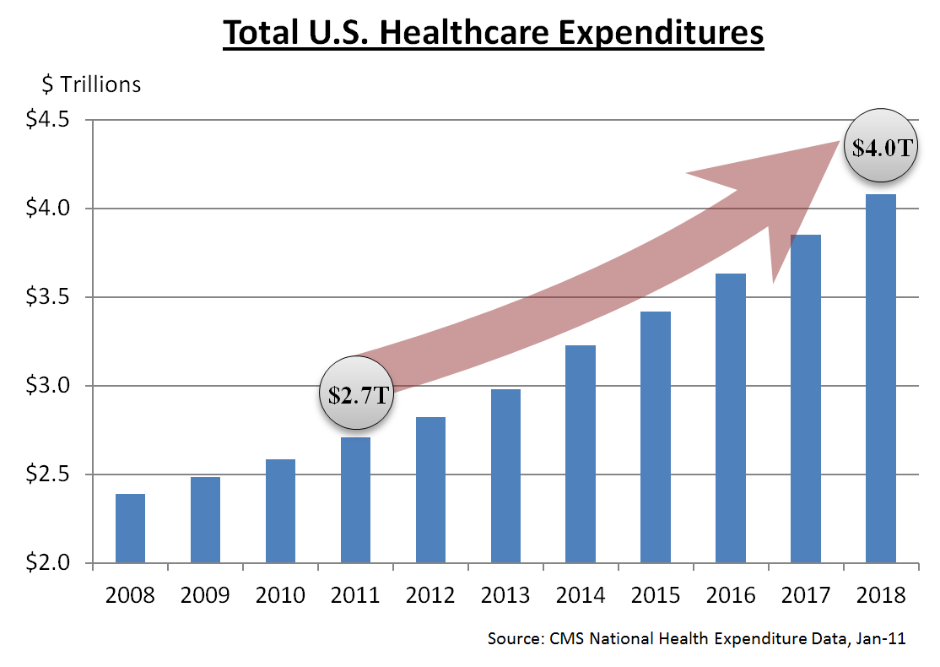

Slide 12
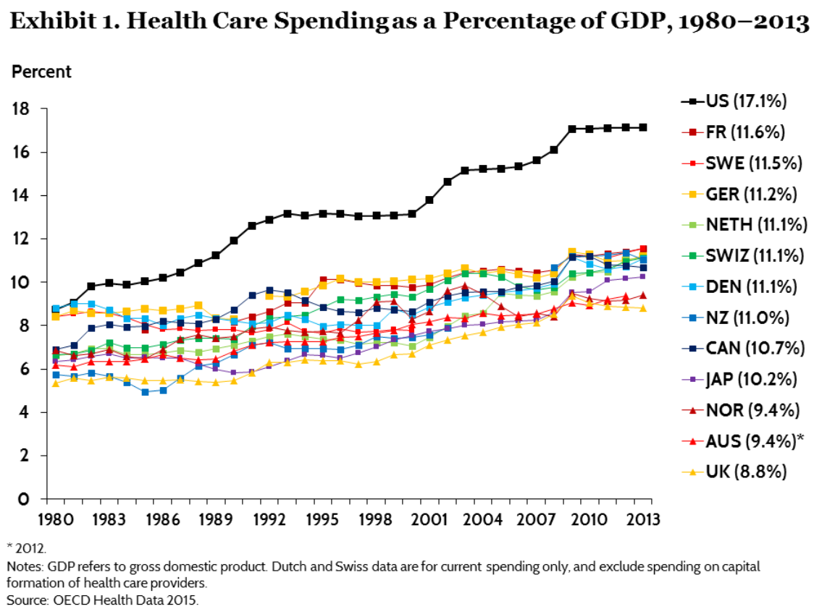

Slide 14
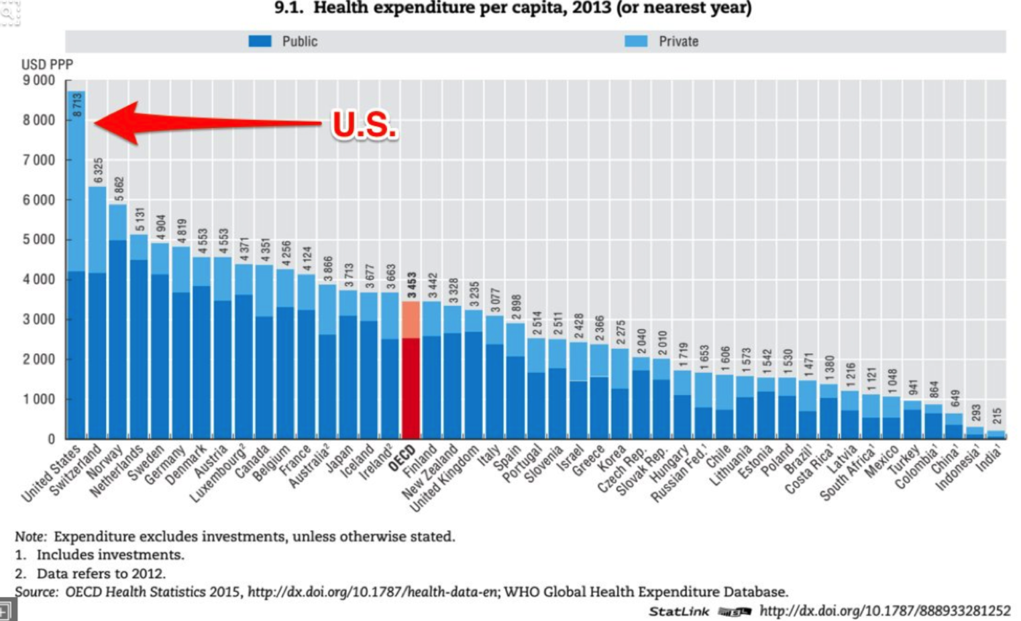

Slide 16
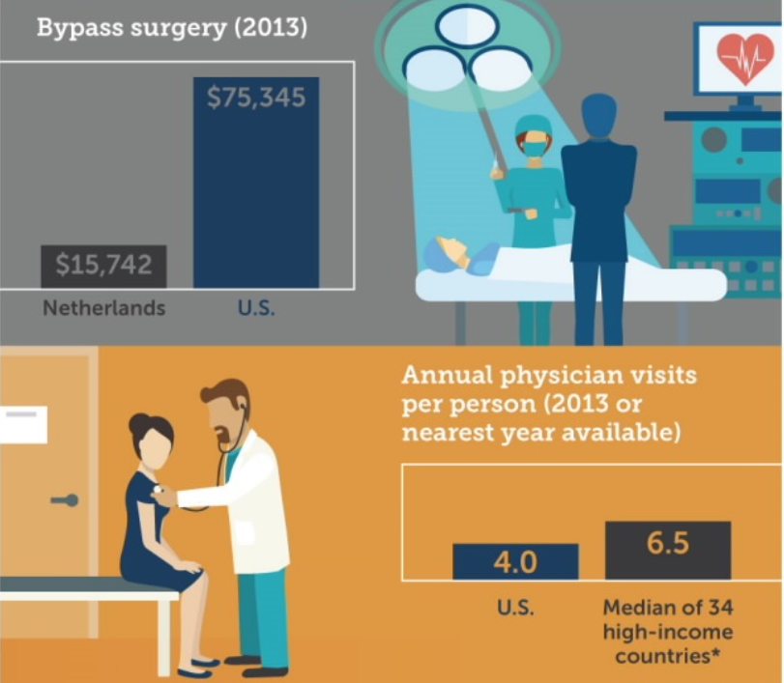

Slide 17
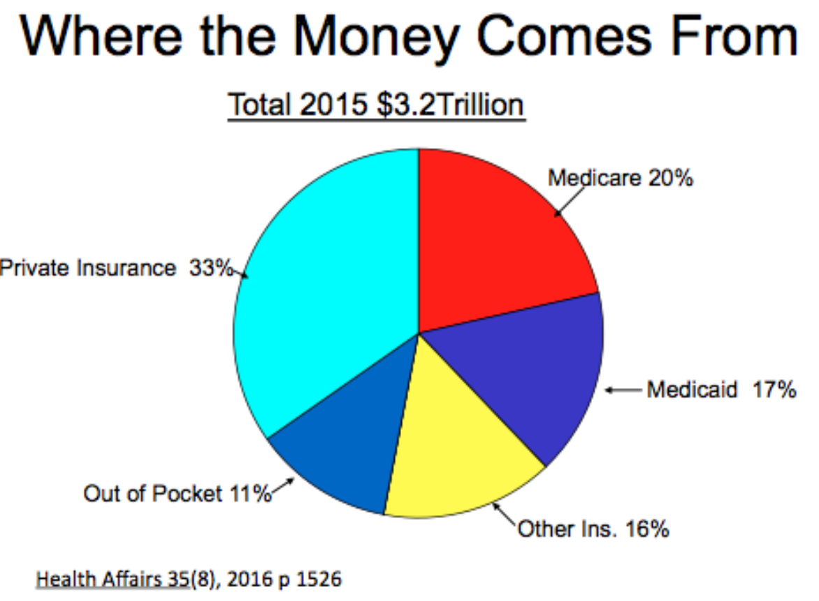

Slide 18
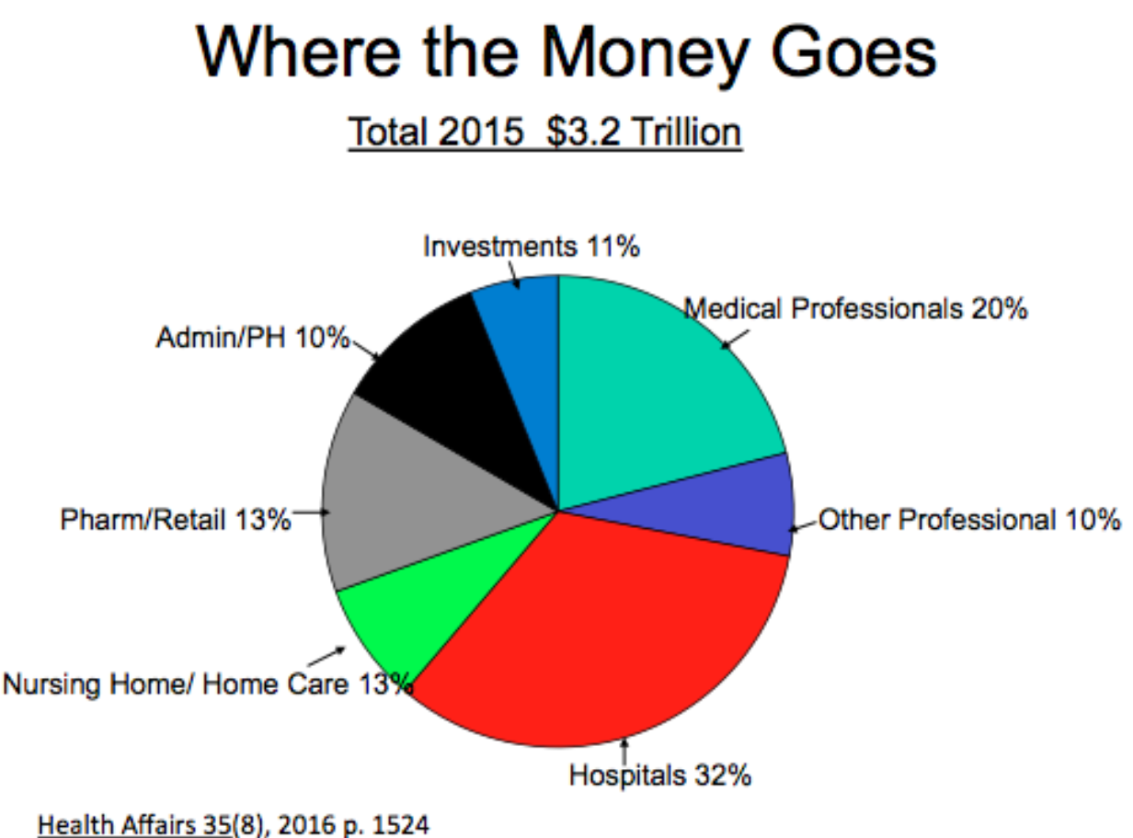

Slide 22
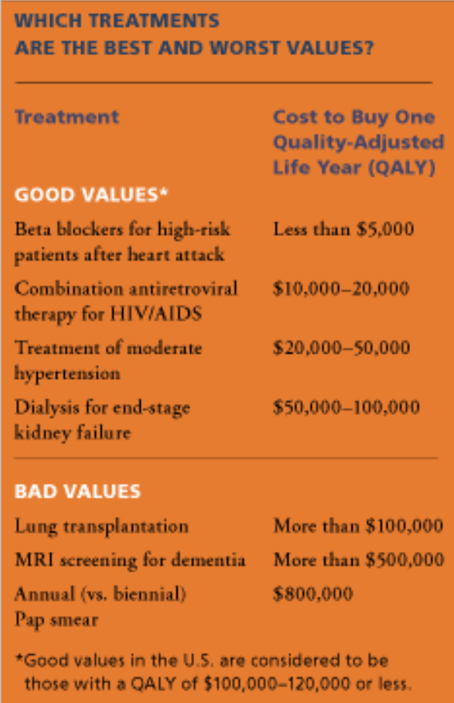

Slide 23
How are our Outcomes?

Slide 24
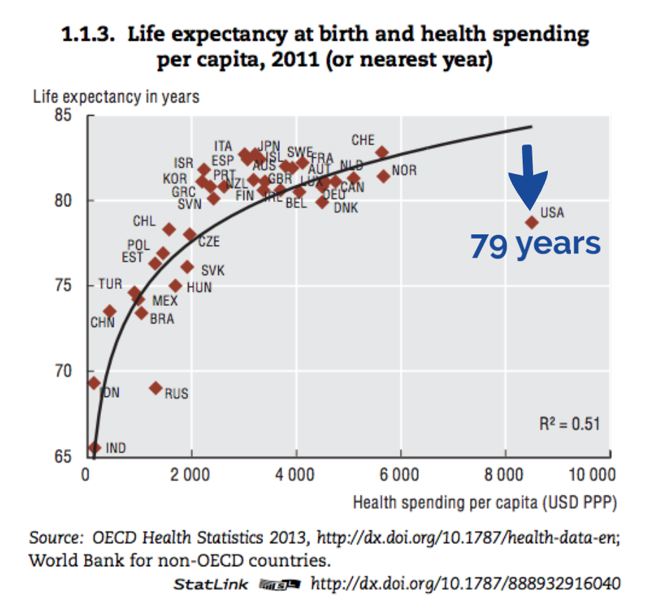

Slide 25
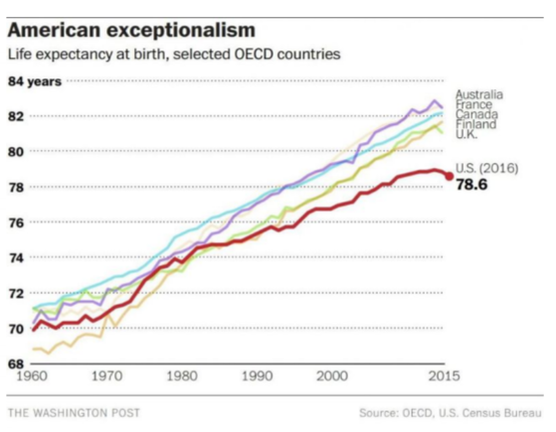
Life Expectancy in the US has declined from 2014 to 2016

Slide 26
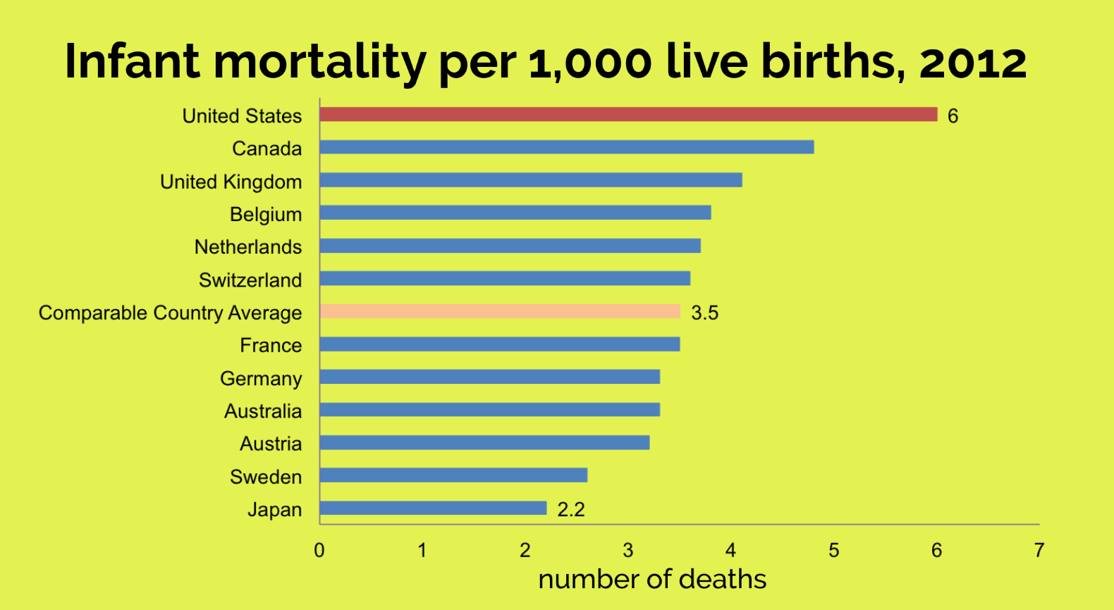

Slide 29
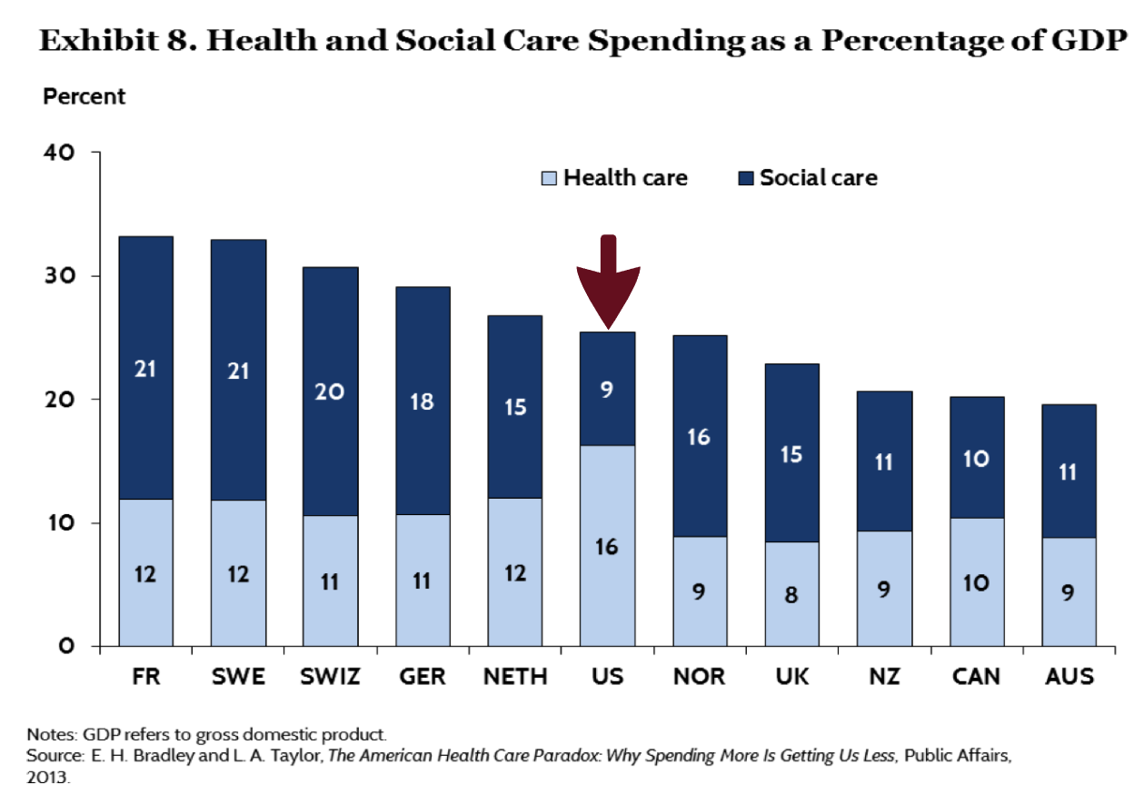

Slide 30
Patient Perspective

Slide 31
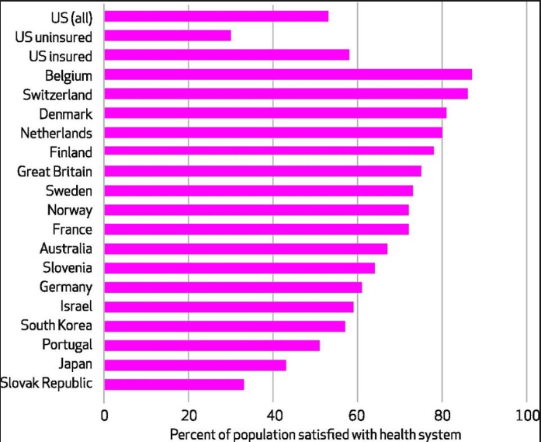
% Satisfied with Health System
https://www.google.com/search?q=are+US+patients+satisfied+with+healthcare&rlz=1T4PLXB_enUS753US754&source=lnms&tbm=isch&sa=X&ved=0ahUKEwi9iuyryb_cAhWjSt8KHQUcA-wQ_AUIDCgD&biw=1920&bih=865#imgrc=xk82E0-eMKSOZM:&spf=1532704533980

Slide 32
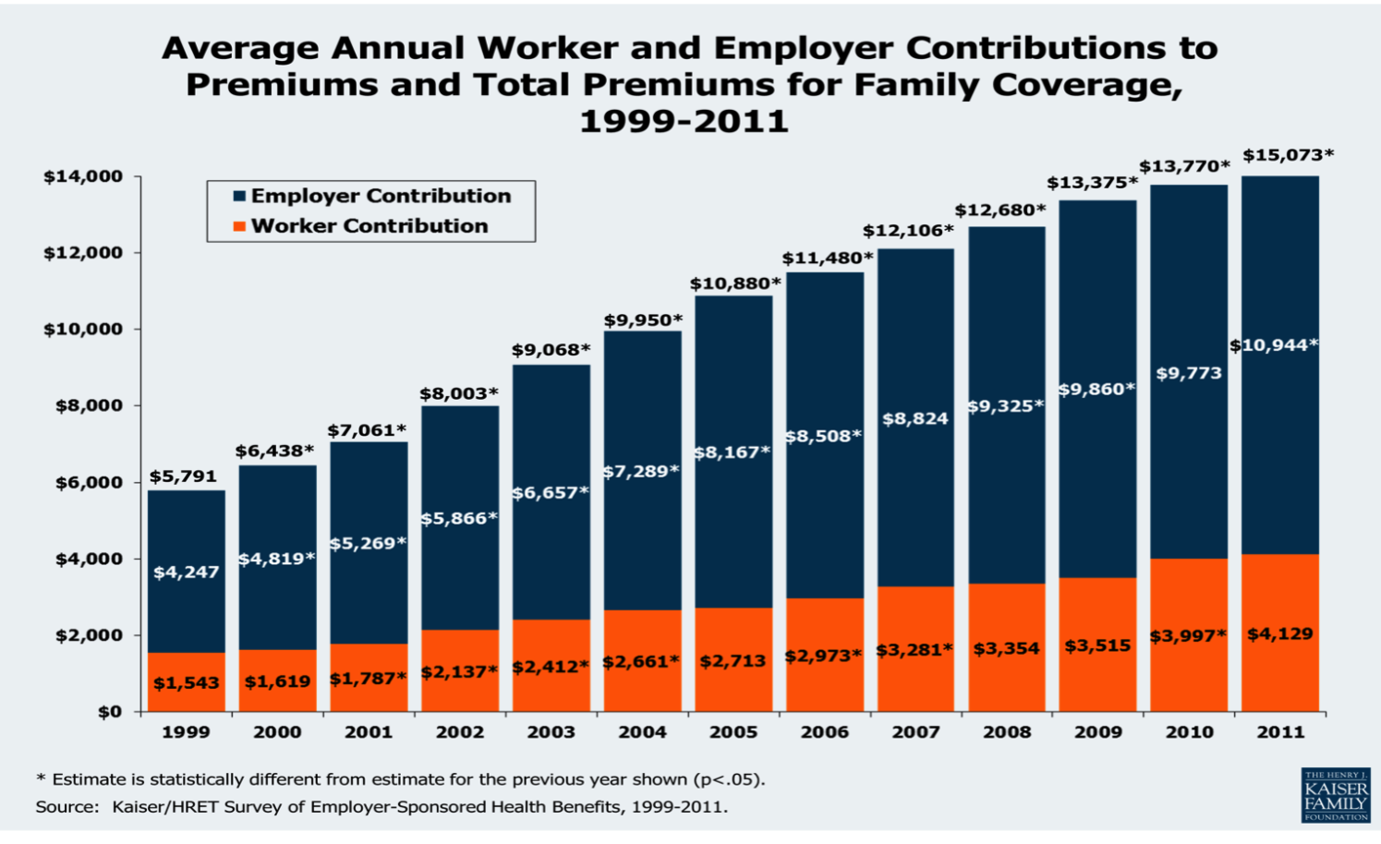

Slide 33
Who is paying??

Slide 34
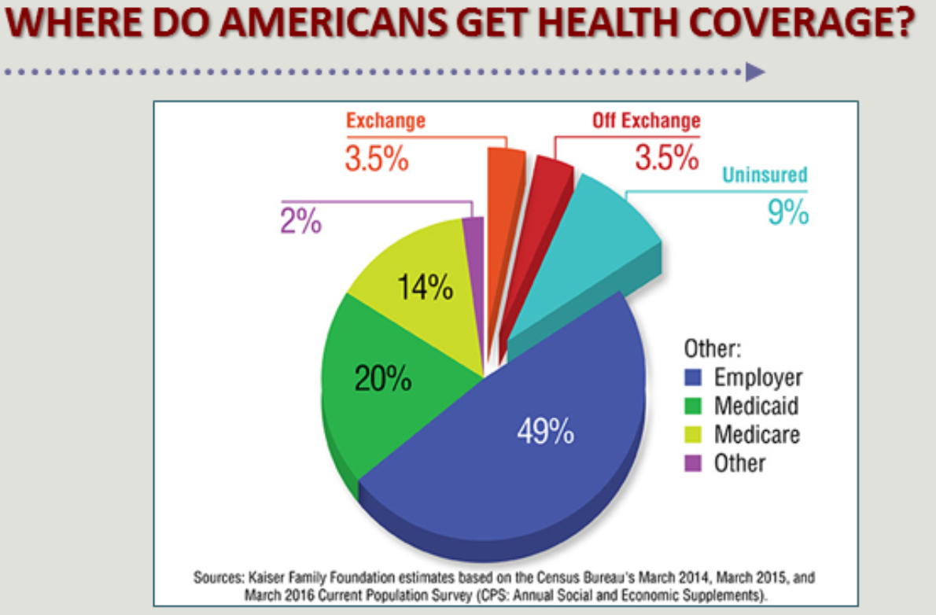

Slide 35
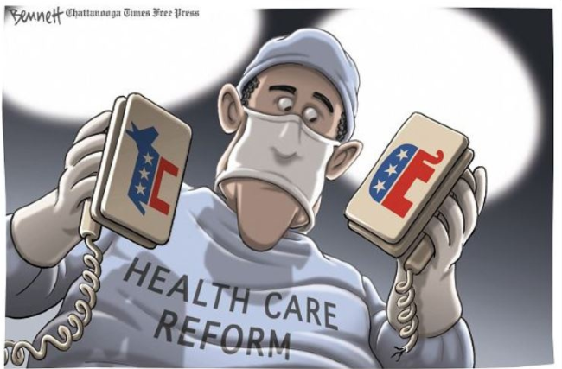
Politics

Slide 36
$$ The Money $$
CONCLUSION
Insurance Company
Employer
Family
Notes:
Before cases

Slide 37
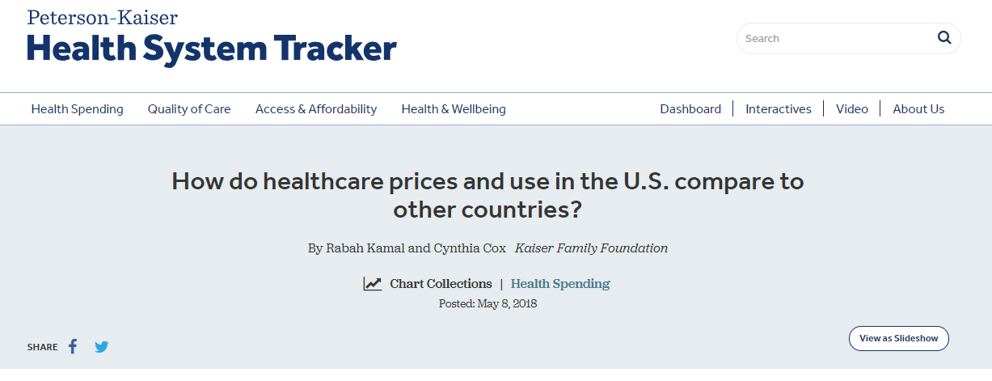
Data on US costs and utilization
https://www.healthsystemtracker.org/chart-collection/how-do-healthcare-prices-and-use-in-the-u-s-compare-to-other-countries/#item-on-average-other-wealthy-countries-spend-half-as-much-per-person-on-healthcare-than-the-u-s

Slide 38
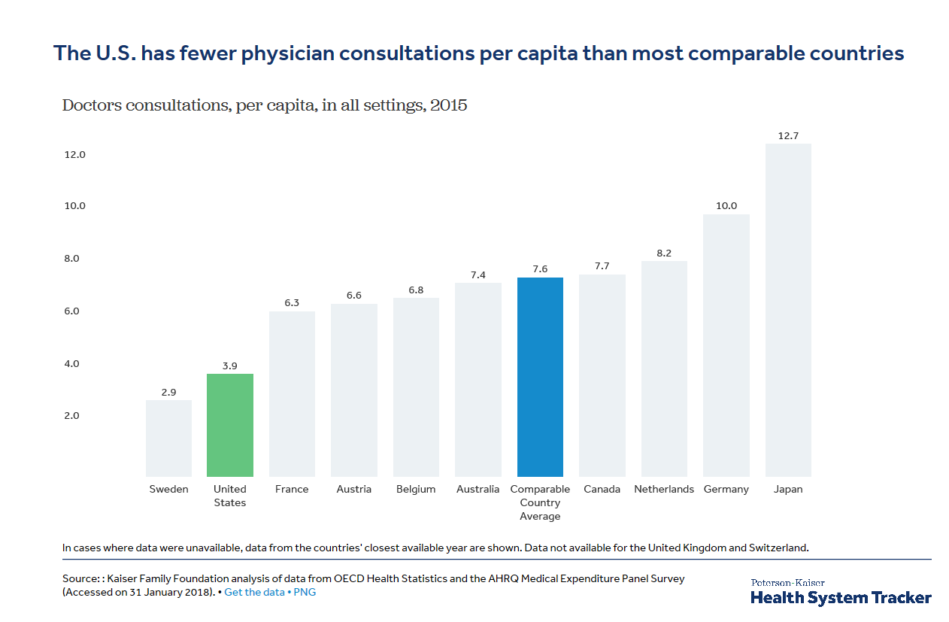
https://www.healthsystemtracker.org/chart-collection/how-do-healthcare-prices-and-use-in-the-u-s-compare-to-other-countries/#item-on-average-other-wealthy-countries-spend-half-as-much-per-person-on-healthcare-than-the-u-s

Slide 39
https://www.healthsystemtracker.org/chart-collection/how-do-healthcare-prices-and-use-in-the-u-s-compare-to-other-countries/#item-on-average-other-wealthy-countries-spend-half-as-much-per-person-on-healthcare-than-the-u-s

Slide 40
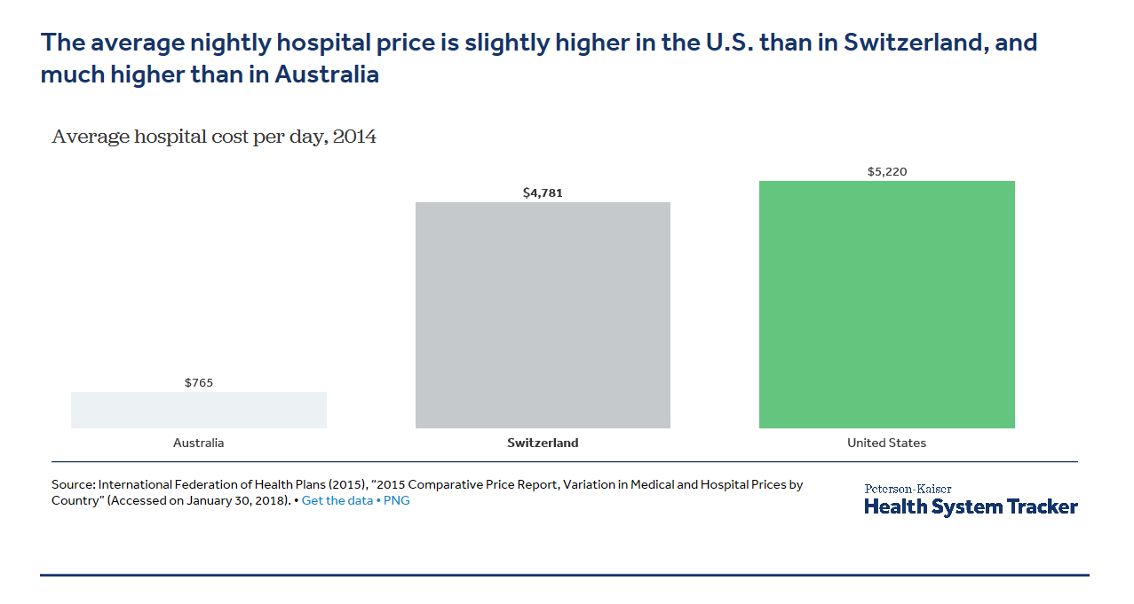
https://www.healthsystemtracker.org/chart-collection/how-do-healthcare-prices-and-use-in-the-u-s-compare-to-other-countries/#item-on-average-other-wealthy-countries-spend-half-as-much-per-person-on-healthcare-than-the-u-s

Slide 41
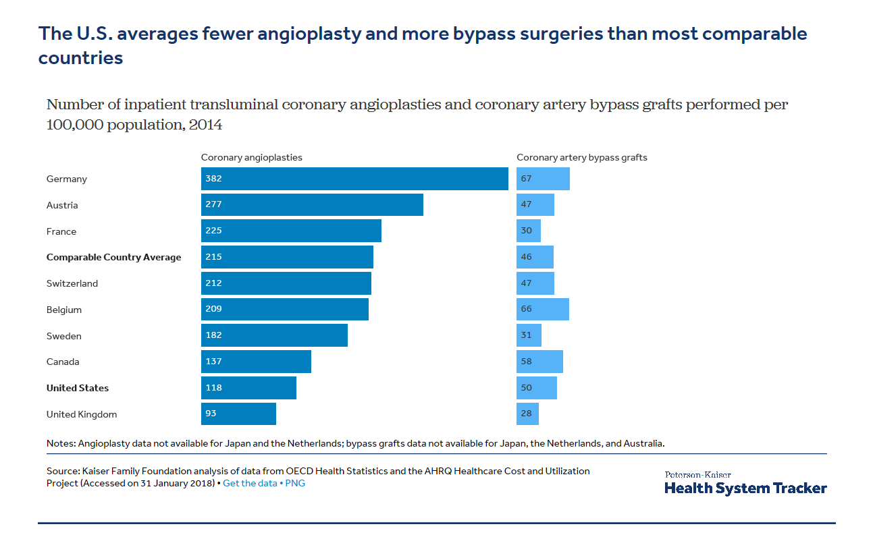
https://www.healthsystemtracker.org/chart-collection/how-do-healthcare-prices-and-use-in-the-u-s-compare-to-other-countries/#item-on-average-other-wealthy-countries-spend-half-as-much-per-person-on-healthcare-than-the-u-s

Slide 42
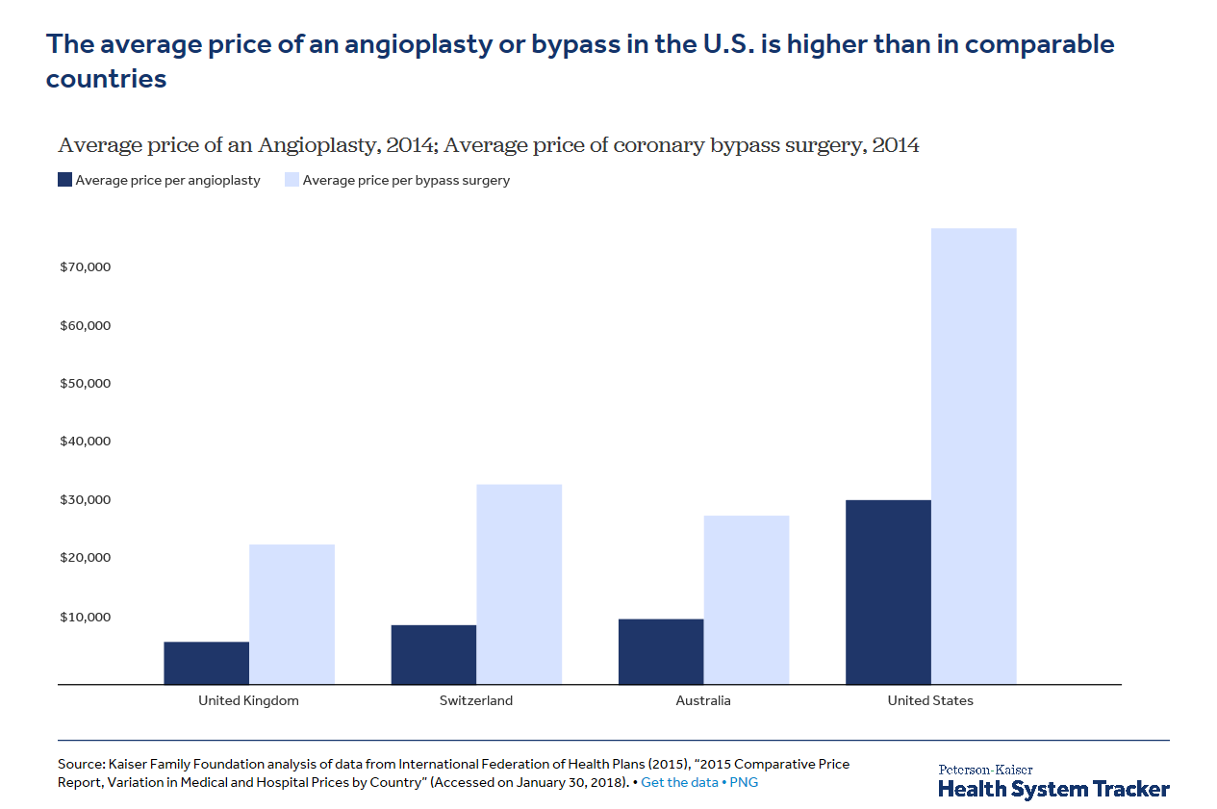
https://www.healthsystemtracker.org/chart-collection/how-do-healthcare-prices-and-use-in-the-u-s-compare-to-other-countries/#item-on-average-other-wealthy-countries-spend-half-as-much-per-person-on-healthcare-than-the-u-s

Slide 43
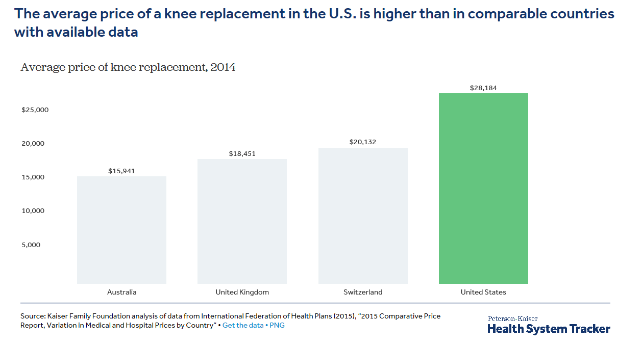
https://www.healthsystemtracker.org/chart-collection/how-do-healthcare-prices-and-use-in-the-u-s-compare-to-other-countries/#item-on-average-other-wealthy-countries-spend-half-as-much-per-person-on-healthcare-than-the-u-s

Slide 44
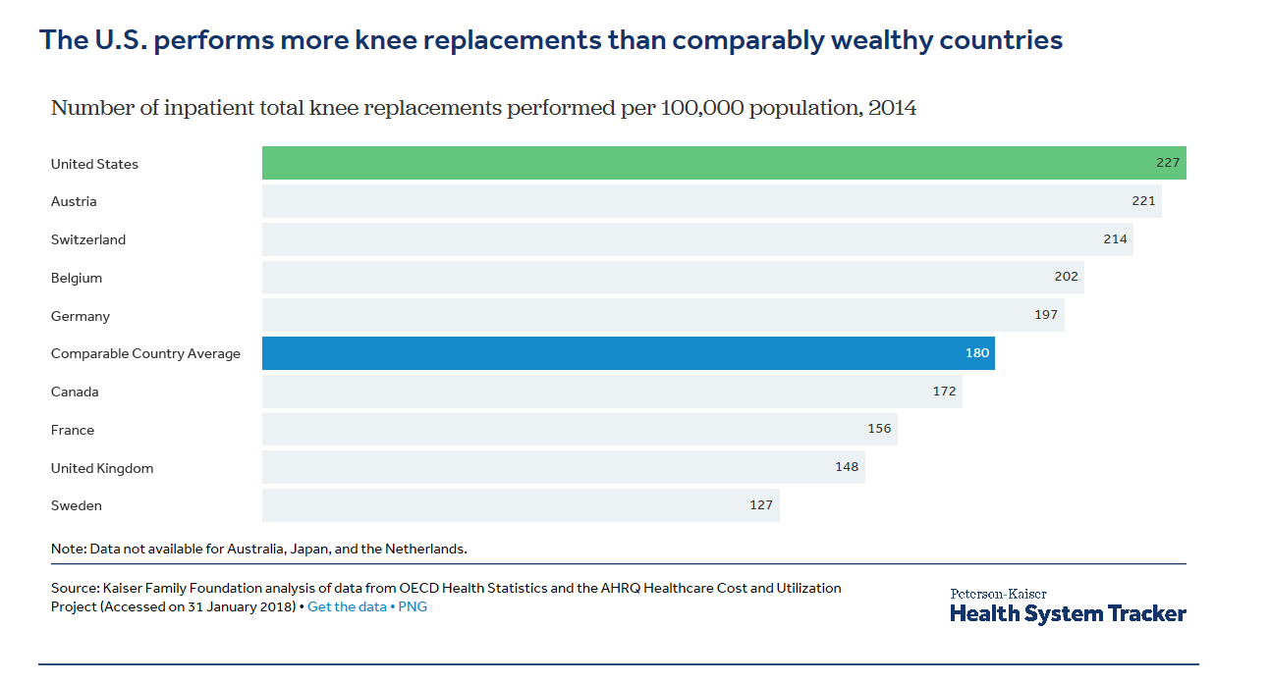
https://www.healthsystemtracker.org/chart-collection/how-do-healthcare-prices-and-use-in-the-u-s-compare-to-other-countries/#item-on-average-other-wealthy-countries-spend-half-as-much-per-person-on-healthcare-than-the-u-s

